Slide 1
NCAA as a Collusive Monopsony
Chapter 18

Slide 2
Lesson: NCAA as a Collusive Monopsony
Objectives:
Explore the economic theory of collusive monopsony
Explain how the NCAA deals with problems inherent in organizing a cartel, coordinating efforts of the members and enforcing the terms of their agreement
Explore the implication of collusive monopsony for price and quantity, and returns to the colluders

Slide 3
NCAA as a Collusive Monopsony
NCAA can be characterized as a cartel – “A combination of independent commercial or industrial enterprises designed to limit competition.
This is especially true in the labor market (students, coaches)
“BUYER CARTEL” or “Collusive Monopsony”:
NCAA’s members collude on two key inputs in the production of athletic competition:
Student-athletes
Agreement restricts quantities by placing a ceiling on the number of scholarships available to each sport.
Compensation is limited to room, board, tuition, books, and incidentals
Bonuses for winning – limited to relatively inexpensive items (rings, watches)
Coaches
Number employed is limited by NCAA Bylaws
Compensation is unconstrained (but there were attempts to restrict earnings)

Slide 4
Incentives to Collude
Remember a monopsony in labor market?
A monopsonist (the only buyer in the market) limits the quantity they buy, thus reducing the price they pay.
For example, a league (the only buyer of labor in the market) limits the number of players it employs.
“Collusive monopsony”: Buyers pool their demands and coordinate their purchases, thus exploiting their power.
Outcome: same as in a monopsony – restricted employment and depressed wages below the competitive level

Slide 5
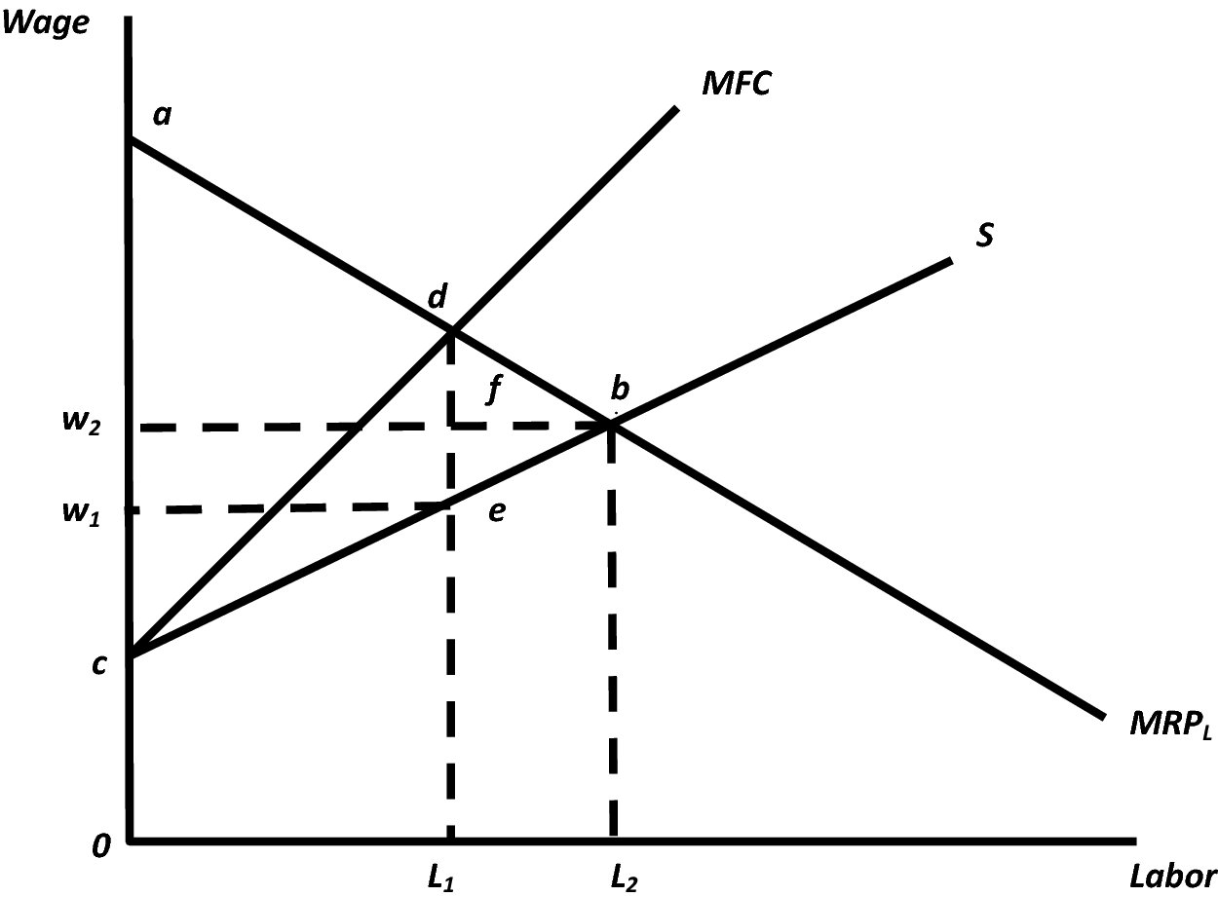
Monopsonistic Exploitation
Point where a monopsonist will operate
MFC = MRP
This would be the equilibrium if the market were competitive: where
Labor Supply = Labor Demand (MRP_{L})
(Result: L₂, wage w₂)
But the monopsonist will NOT buy as much labor, since the cost MFC exceeds the benefit (MRP)
(Result: L₁, wage w₁)
MRP > wage
Notes:
http://opendorse.com/blog/2016-highest-paid-athlete-endorsers/
http://www.totalsportek.com/money/biggest-endorsement-deals-sports-history/
https://www.underarmour.com/en-us/ua-roster
https://en.wikipedia.org/wiki/List_of_Nike_sponsorships

Slide 6
Protecting Amateurism or Exploiting Monopsony Power?
NCAA: “We are dedicated to defending amateurism”
But is everyone in college sports amateur?
Only student athletes are amateur
Coaches, athletic directors are paid professionals
Are college athletics amateur events or a big business?
Major sports programs: TV revenues, bowl revenues, stadium revenues, endorsement deals, licensing fees for intellectual property

Slide 7
Protecting Amateurism or Exploiting Monopsony Power?
Monopsonistic exploitation of student-athletes
Student-athletes have property rights in their images and likeness used in TV advertising, posters, calendars, apparel, video games, film clips and rebroadcasts of classic games.
Condition of eligibility: students must grant these rights to the NCAA
NCAA (or the institution) gets all licensing fees
Some former athletes have filed separate lawsuits objecting to NCAA’s licensing of their images without compensation

Slide 8
Effect of Collusive Monopsony on Costs
OK, so firms in a collusive monopsony are paying a lower price for labor. Does that mean they will charge consumers less for admission?
Answer: No. A cartel pays a lower price for input (labor). So intuitively, lower costs should lead to higher output and lower prices to consumers. In reality, the opposite happens: cartel will produce a lower output and higher prices to consumers

Slide 9
Effect of Collusive Monopsony on Costs
On the graph:
A Collusive Monopsony will cause the industry marginal cost (MC) to shift upward. Why?
PERFECT COMPETITION: An employer must pay a competitive wage (which is constant, and is defined by the labor market equilibrium).
MONOPSONY: An employer-monopsonist does not have a constant wage. The more labor they employ, the higher marginal wage they pay. But if they pay this higher wage to one new player, they have to pay it to everyone who is employed.
Result: monopsony MC lies above competitive MC
A Collusive Monopsony will cause the industry average cost (ATC) to shift down and left. Why?
A monopsonist reduces the quantity of labor – thus average cost decreases (ATC curve shifts down and left). This is the source of profits for a cartel

Slide 10
NCAA: A Collusive Monopsony
As a cartel, NCAA faces the usual problems as all buyer cartels:
Deciding on payments
Imposing hiring quotas
Limiting nonprice competition
Sharing profits
Coordinating activities
Deterring cheating

Slide 11
Limits on Prices and Quantities
Policies are set in NCAA Bylaws
General rules for athletes:
Athletes may not receive more than a “full grant-in-aid” – “Financial aid that consists of tuition and fees, room and board, and required course-related books”
Rules prevent loopholes (e.g. to recruit some football players and put them on track scholarships)
General rules for cartel members:
Limitation on expenditures. Schools may compete by hiring the best coaches ($2 - $5 mln), offering expensive training faculutues, extensive educational counseling and tutoring. All of these reduce cartel’s profits. Thus NCAA has rules curtailing such expenditures
Limitation on the number of coaches. A “countable” coach – anyone who “participates in the coaching of the intercollegiate team in practice, games, or organized activities directly related to that sport”. Limit: 1 head coach, 9 assistant coaches, 2 grad assistant coaches. In addition, a strength and conditioning coach
Notes:
http://www.si.com/college-football/2017/02/04/shawne-alston-grant-aid-class-action-lawsuit-ncaa-settlement

Slide 12
Monopsony Sources
Revenue Sharing
Gate receipts shared with the opposing teams
Bowl revenues shared within a conference
TV revenues are shared
NCAA basketball tournament revenues are shared
But financial imbalance exists: Individual institutions keep private donations, trademark licensing fees, concession revenues, most gate receipts.
Sanctions for Cheating
Started in 1946 - 1953
Purpose: To make it unprofitable to cheat.
Example: When NCAA found UW guilty of recruiting violations, penalties included: (1) a 2-year ban on bowl participation; (2) a 1-year ban on receiving TV revenue; (3) a reduction in football scholarships for 2 years; (4) a reduction in the number of permissible football recruiting visits for 2 years; (5) a 2-year probation
Extreme case: “Death Penalty” – suspending the program for 1 -2 years (E.g. SMU)
Notes:
http://www.si.com/college-football/2017/02/04/shawne-alston-grant-aid-class-action-lawsuit-ncaa-settlement

Slide 13
Antitrust Challenges by Coaches
Hennessey v. NCAA
1975: NCAA members agreed to limit the max number of assistant football and basketball coaches (only for Division I schools)
Result: Hennessey (assistant coach for 16 years) was demoted to part-time status and lost 90% of compensation
Hennessey filed an antitrust lawsuit against NCAA based on Sherman Act (that forbids “contracts, combinations, and conspiracies in restraint of trade”
Decision: Court did not find “unreasonable” restraint of trade

Slide 14
Antitrust Challenges by Coaches
Law v. NCAA
NCAA tried to reduce the salaries paid to certain assistant coaches
NCAA Bylaw 11.02.3 – had as a goal to stabilize and depress the compensation of the coaches designated as “restricted earnings coaches”
1989: NCAA formed the Cost Reduction Committee. Purpose: to reduce costs without hurting competitive balance or curtailing access to higher education by student-athletes. Decision: (1) to reduce the number of coaches in all Division I sports; (2) One coach in every sport (except football) was to be designated as a ”Restricted earnings coach” (limited to $12k during the year and $4k during summer)
Result: Court ruled in favor of the plaintiffs

Slide 15
Antitrust Challenges by Student-Athletes
NCAA I-A Walk-on Football Players Litigation
NCAA tried to limit the number of football player grants-in-aids
Walk-on players – players who are not paid.
Premise: Walk-on players argued that they would be paid, had it not been for the limits
Result: NCAA prevailed with an argument that the class of plaintiffs should not be certified. This means that there was no “class” of scholarship candidates that were wronged.
What do you think? Does NCAA reduce the quality of its product by limiting scholarships/number of players?

Slide 16
Antitrust Challenges by Student-Athletes
White v. NCAA
Premise: The amount of scholarship to football and basketball players since Feb 2002
Plaintiffs claimed: Collusion among NCAA members led to a grant-in-aid cap that was less than the actual cost of attending college. Thus they wanted to be paid the difference
Result: A settlement: NCAA denied the wrongdoing, but agreed to make available a fund of $218 mln to aid student-athletes with “demonstrated financial and / or academic needs” and a $10 mln fund to reimburse former players
O’Bannon v. NCAA
Premise: NCAA makes student-athletes surrender property rights to their own name and images (sign Form 08-3a). NCAA also permits the use of an athlete’s likeness, picture or name in school and conference promotions, but all money goes directly to school or conference.
O’Bannon challenged NCAA’s presumption that it can use the likenesses in perpentuity
Latest class action against NCAA

